Slide 1


Slide 2


Slide 3
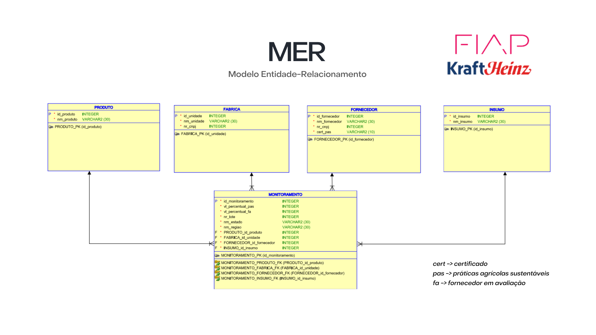

Slide 4
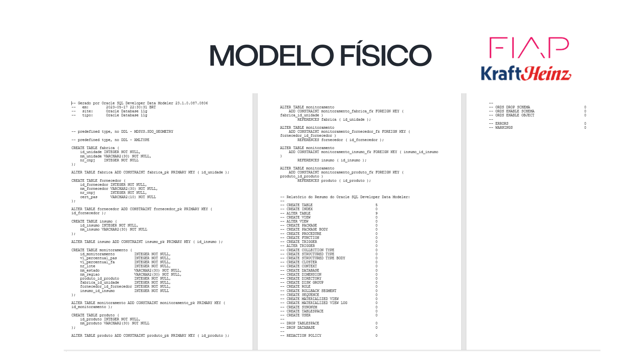

Slide 5
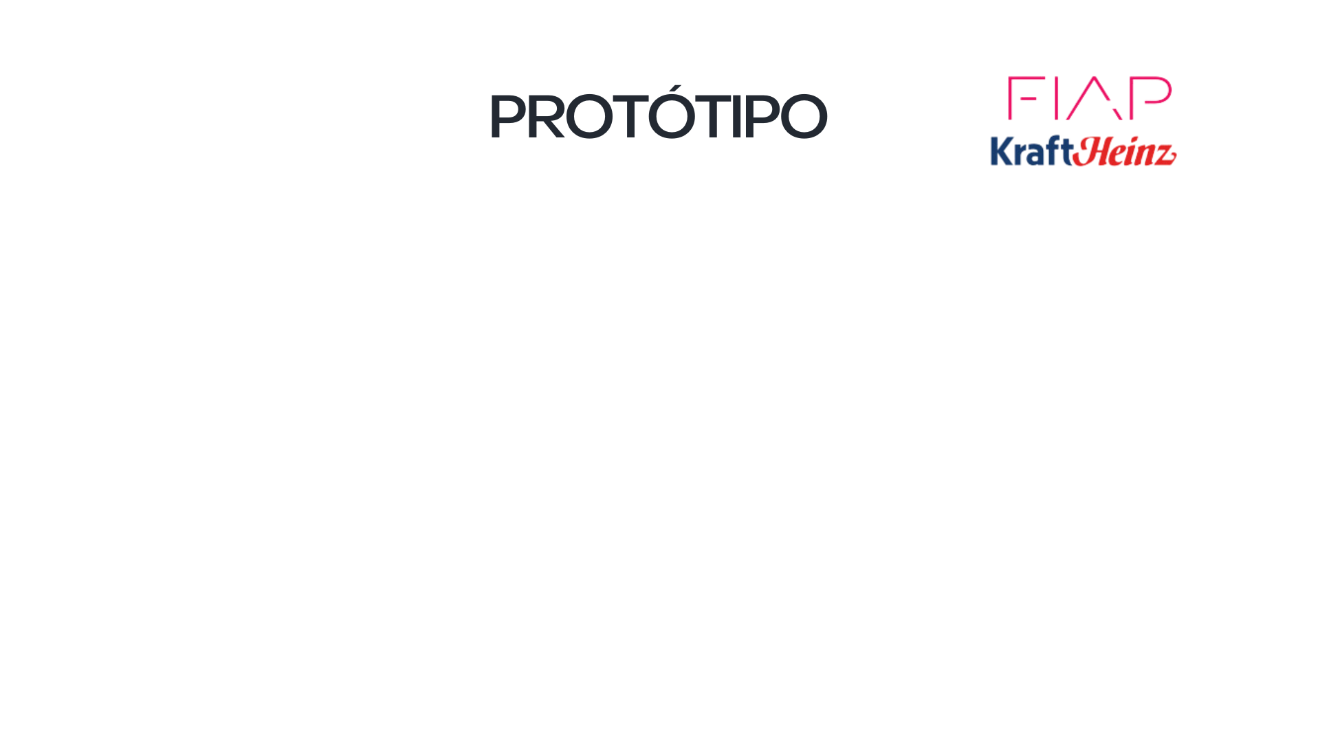
https://www.figma.com/proto/sQ0pRtEv8Su6URdc9SST64/Prot%C3%B3tipo-Heinz?node-id=1-173&starting-point-node-id=1%3A173

Slide 6
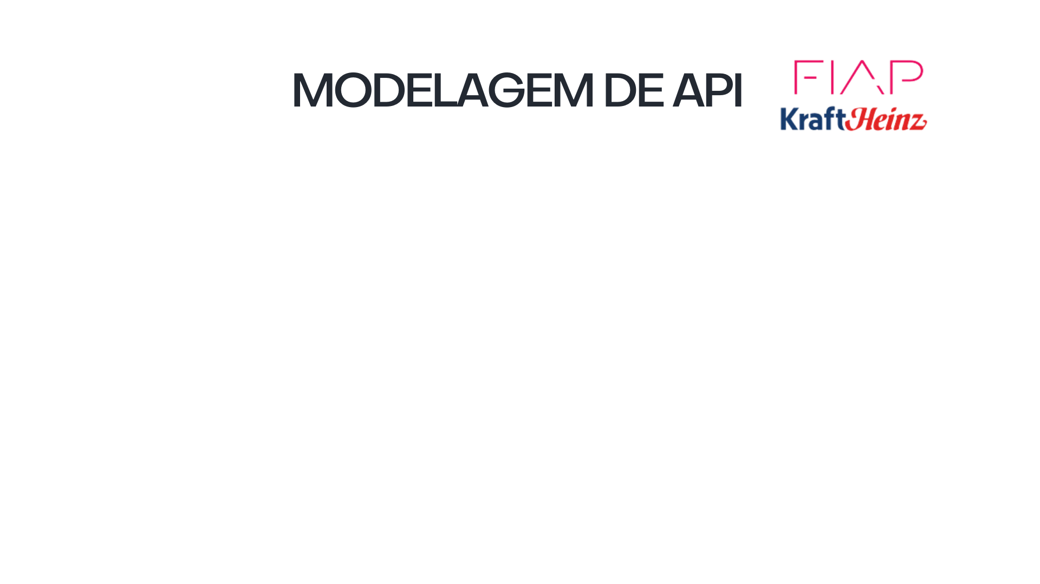
https://app.swaggerhub.com/apis/HENRIQUEALMMEIDA_1/Heinz2/1.0.0

Slide 7


Slide 8


